Slide 1
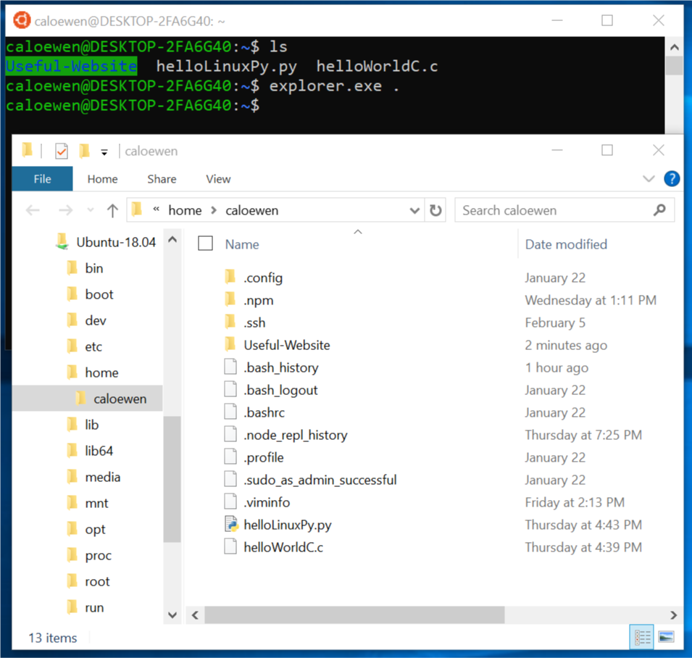
Objective: Navigating a File System
Intro Task:
Go to Google Classroom
Answer the questions in the doc “Navigating a File System - Do Now”

Slide 2
Objective: Navigating a File System
Vocabulary
Drive
Folder/Directory
File
Root Directory/root folder
Sub-directory/sub-folder
Keys to Success (KtS)
What’s the diff?

Slide 3
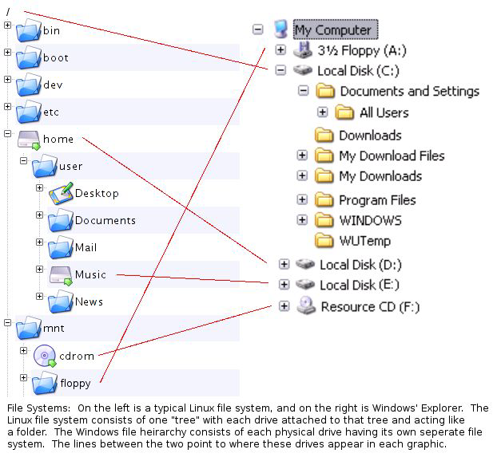
Objective: Navigating a File System
A Windows PC has at least as many file systems as disks.
A physical drive is a hard disk (HDD), solid state drive (SSD), compact disk (CD) etc. Each has its own file system: A:\, C:\, etc.
We can partition disks into logical drives to keep data separate. C:, D:, and E: may be one SSD, divided into programs, personal data, and entertainment or multimedia files.

Slide 4
Objective: Navigating a File System
An absolute path, aka. full path, tells us exactly where a file or folder is. We could have an “All Users” folder inside every folder you see on the right (except Downloads or WUTemp). But C:\Documents and Settings\AllUsers\ can refer to only one of them.
(How many directories does the path above contains?)

Slide 5
Objective: Navigating a File System
In Windows, all absolute paths start with a drive letter, followed by a colon, e.g. F:\
Often, the last backslash is omitted, but then you wouldn’t know if it’s a file. C:\Documents and Settings\AllUsers

Slide 6
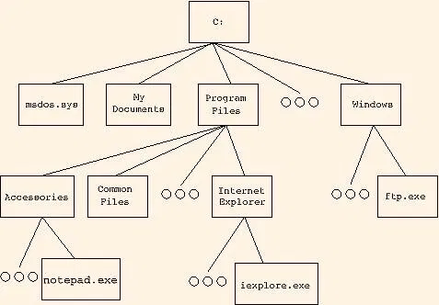
Objective: Navigating a File System
From here, we’ll say directory in stead of folder.
File trees are mostly drawn this way, with the root directory on top. Here, we see C:\ has at least 3 subdirectories & 1 file.
We say Accessories is a subdirectory of Program Files, which means Accessories is a directory inside Program Files. That makes Program Files the parent directory of Accessories. Thus, a file cannot be a parent.

Slide 7
Objective: Navigating a File System
Now it’s your turn. Open the file “Navigating a File System - Classwork” and complete the assignment. Remember to click the blue “Submit” button when you are done. Assignments will NOT be graded until you do so.
All assignments have a due date on Google Classroom, after which Mr. Lee may grade them at anytime. They will be considered late if not submitted by the time he grades it. All unsubmitted assignments will have a grade of 0 on PupilPath.
You can resubmit each assignment once, whether as makeup or for higher grade. Email Mr. Lee with the title of the assignment when it is done, otherwise the request will not be fulfilled. The second grade will be final.
Late penalty of up to 25% will be assessed if submitted before the corresponding unit exam, although most of the times only 5-10% will be deducted if submitted within a reasonable time. After that unit’s exam, up to 75% will be deducted.

Slide 8
Objective: Navigating a File System
Linux, on the other hand, puts all disks and devices, even printers, in the same file system under the root directory /, read as “root”.
We also use the symbol to separate directories (in a command line world, all folders are called directories). So, /bin or /bin/ is pronounced “root, bin”. /home/user/ is pronounced “root, home, user”.
All *nux full paths begin with root. Names that end with / are folders.

